Slide 1
EXPLORATORY DATA ANALYSIS
RAW HOUSE DATA
John Steele

Slide 2
Overview
1
Data Summary
Technologies Used
Data Cleaning
- Nulls and Zeros
- Outliers
- Additional Cleaning Notes
Saving the Clean Data
Plotting and Graphing
Conclusion

Slide 3
Data Summary
1
File ‘raw_house_data.csv’
Contains data on private real-estate that has sold.
MLS
latitude
bedrooms
kitchen_features
sold_price
lot_acres
bathrooms
fireplaces
Zipcode
taxes
sqrt_ft
floor_covering
longitude
year_built
garage
HOA

Slide 4
Technologies Used
1
Colabs - a cloud-based Jupyter notebook environment
Python libraries:
  Pandas – handles data manipulation and analysis
  Matplotlib: PyPlot – provides MATLAB type plotting interface
  Seaborn – makes statistical graphics in Python by building on top of Matplotlib and integrates closely with Pandas data structures

Slide 5
Data Cleaning – Nulls and Zeros
1
FEATURE | ANALYSIS | ACTION TAKEN
MLS* | 0 dups, 0 nulls | No action required.
sold_price | 0 nulls | No action required.
zipcode | 0 nulls | No action required.
longitude | 0 nulls | No action required.
latitude | 0 nulls | No action required.
lot_acres | 10 nulls, 35 zeros | Nulls replaced by mean. Zeros replaced with mean.
taxes | 0 nulls | No action required.
year_built | 0 nulls, 5 zeros | Replaced zeros with mean.
MLS* – Multiple Listing Service

Slide 6
Data Cleaning – Nulls and Zeros
FEATURE | ANALYSIS | ACTION TAKEN
bedrooms | 0 nulls, 0 zeros | No action required.
bathrooms | 6 nulls, 0 zeros | Nulls replaced with mean.
sqrt_ft | 54 nulls | Nulls replaced with mean.
garage | 5 nulls | Nulls replaced with 0.
kitchen_ features | 33 nulls | Nulls replaced with ‘None’.
fireplaces | 0 nulls | No action required.
floor_ coverings | 1 null | Null replaced with ‘None’.

Slide 7
Data Cleaning – Nulls and Zeros
FEATURE | ANALYSIS | ACTION TAKEN
HOA* | 557 nulls | Replaced with -1.
HOA* - Column was HOA fees.
Null means no HOA exist.
Still need to be able to work with that data.
Numbers greater than or equal to 0 were HOA yearly fees.

Slide 8
Data Cleaning – Outliers
How outliers were determined:
Viewed boxplots
Removed those that were ‘visibly’ far.
Removed only the bare minimum.
Removed a total of 15 outliers out of 5000 observations.
FEATURE | OUTLIERS REMOVED
lot_acres | 4
taxes | 2
bedrooms | 3
bathrooms | 1
HOA | 5

Slide 9
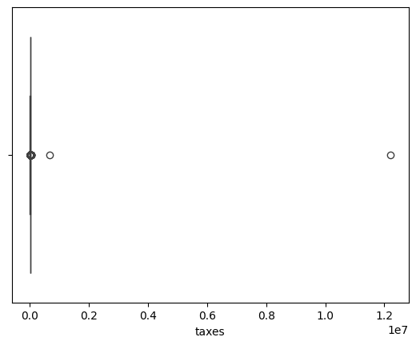
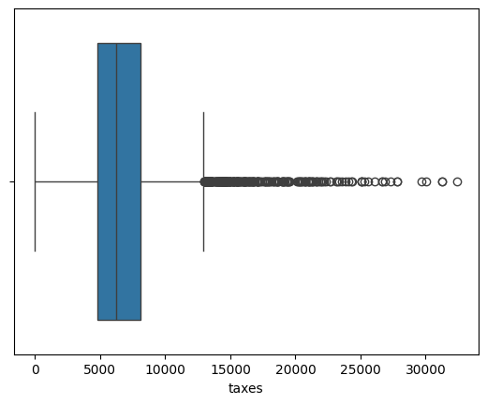
Plotting and Graphing
After removing 2 outliers

Slide 10
Data Cleaning – Additional Cleaning Notes
FEATURE | ACTION TAKEN
MLS | No analysis, this is an indexing feature. Included in cleaned data file.
kitchen_ features | Rearranged features list to be alphabetical and no spaces. For example, ‘Dishwasher, Freezer, Refrigerator, Oven’ became ‘Dishwasher,Freezer,Oven,Refrigerator’. Can be used as keys.
fireplaces | Was labeled as ‘object’ in original data. Now labeled as ‘float’ in cleaned data.
floor_ coverings | Same as with kitchen_features.
The method ‘drop_duplicates()’ was performed after cleaning.
No duplicates were found.

Slide 11
Saving the Clean Data
Clean data saved in ‘raw_house_data_clean.csv’.
All features were saved to new file cleaned and ready to go.

Slide 12
Plotting and Graphing
Columns were renamed to be more ‘visual-friendly’.
Previous label | New label | Previous label | New label
sold_price | Sold Price | bedrooms | Bedrooms
zipcode | ZIP Code | bathrooms | Bathrooms
longitude | Longitude | sqrt_ft | Sqaure Footage
latitude | Latitude | garage | Garage
lot_acres | Lot Acres | kitchen_features | Kitchen Features
taxes | Taxes | fireplaces | Fireplaces
year_built | Year Built | floor_covering | Floor Covering

Slide 13
Plotting and Graphing
All features were plotted on HISTOGRAMS, PAIR PLOTS, HEATMAP, and BOXPLOTS except those in bold.
MLS, Sold Price, ZIP Code, Lot Acres, Taxes, Year Built, Bedrooms, Bathrooms, Square Footage, Garage, Kitchen Features, Fireplaces, Floor Covering, HOA

Slide 14
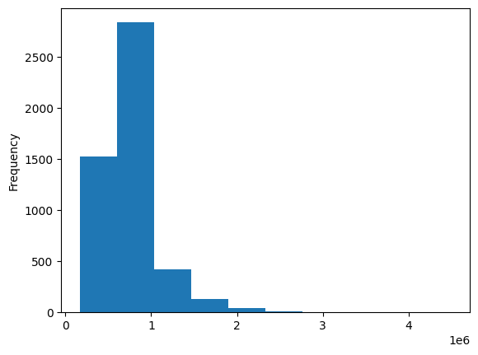
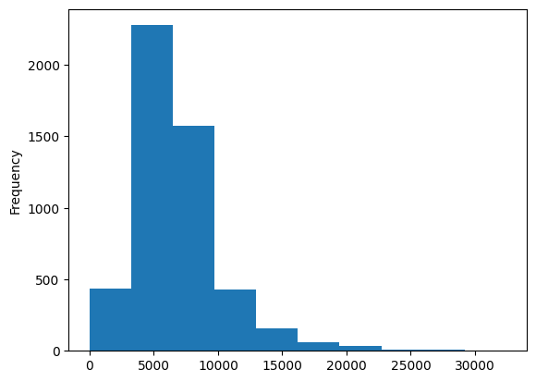
Plotting and Graphing
Sold Price
Taxes

Slide 15
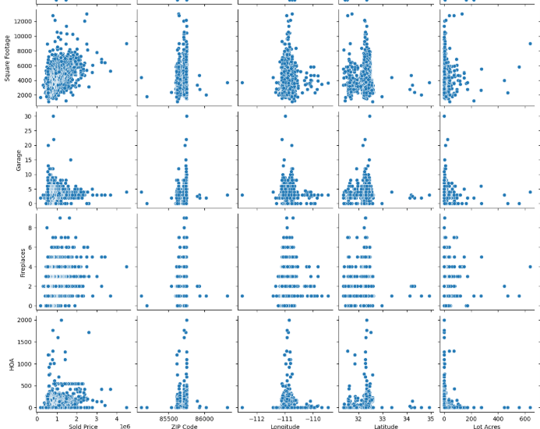
Plotting and Graphing

Slide 16
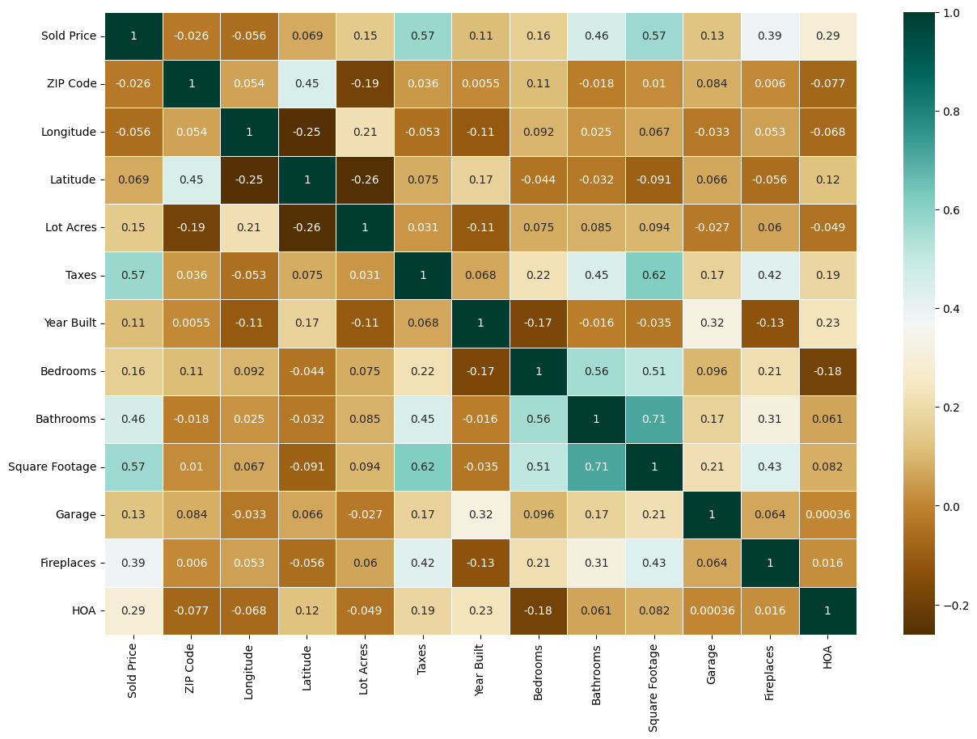
Plotting and Graphing

Slide 17
Conclusion
All data has been cleaned and is ready for further analysis.

